Slide 1

Course Title: Computer Network
Course Code : CSE313
Name : Thanjida Akhter
ID : 102-15-1030.
.

Slide 2
TOPIC
1.Wireless Sensor Network.
2. Sensor Node.
3. Sensor Network.
4.Usage of WSN.

Slide 3
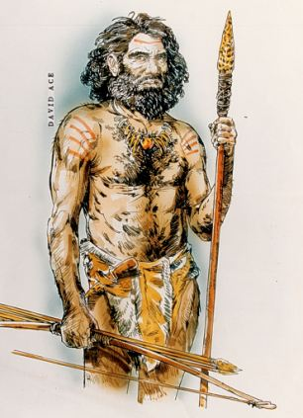
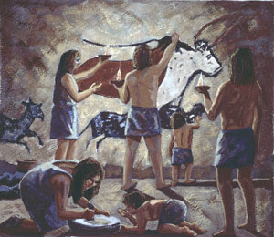


Slide 4
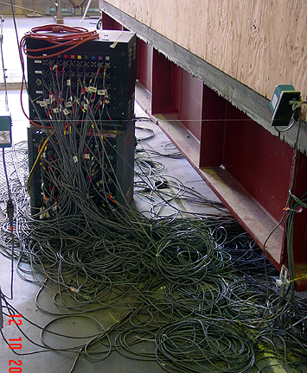


Slide 5
Introduction
Wireless Sensor Networks are networks that consists of sensors which are distributed in an ad hoc manner.
These sensors work with each other to sense some physical phenomenon and then the information gathered is processed to get relevant results.
Wireless sensor networks consists of protocols and algorithms with self-organizing capabilities.

Slide 6
Wireless Sensor Networks
A wireless sensor network (WSN) is a wireless network consisting of spatially distributed autonomous devices using sensors to cooperatively monitor physical or environmental conditions, such as temperature, sound, vibration, pressure, motion or pollutants, at different locations.

Slide 7
Wireless Sensor Networks
continue …
The development of wireless sensor networks was originally motivated by military applications such as battlefield surveillance. However, wireless sensor networks are now used in many civilian application areas, including environment and habitat monitoring, healthcare applications, home automation, and traffic control.

Slide 8
Sensor Node
Networks of typically small, battery-powered, wireless devices.
On-board processing,
Communication, and
Sensing capabilities.
Sensors
P
O
W
E
R
Storage
Processor
Radio
WSN device schematics

Slide 9
Sensor Node
continue …
In addition to one or more sensors, each node in a sensor network is typically equipped with a radio transceiver or other wireless communications device, a small microcontroller, and an energy source, usually a battery.
Sensors
P
O
W
E
R
Storage
Processor
Radio
WSN device schematics

Slide 10
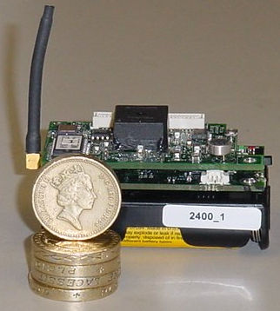
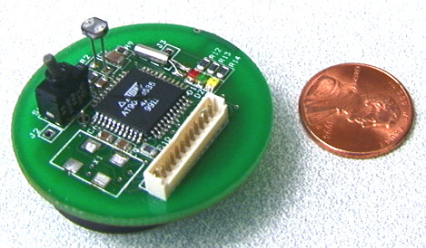
Sensor Node
continue …

Slide 11
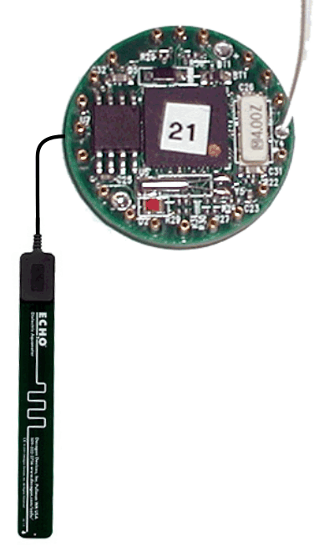
Sensor Network
Antenna
Server
Interface electronics, radio and microcontroller
Soil moisture probe
Sensor field
Communications barrier
Node
Gateway
Internet

Slide 12

Sensor Network
Server
Watershed
Sensor field
Gateway
Internet

Slide 13
Network Model for WSN
A wireless sensor network consists of hundreds or thousands of low cost nodes which could either have a fixed location or randomly deployed to monitor the environment. The flowing of data ends at special nodes called base stations (sometimes they are also referred to as sinks).

Slide 14
Network Model for WSN
continue …
A base station links the sensor network to another network (like a gateway) to disseminate the data sensed for further processing. Base stations have enhanced capabilities over simple sensor nodes since they must do complex data processing.

Slide 15
Network Model for WSN
continue …
This justifies the fact that bases stations have workstation/laptop class processors, and of course enough memory, energy, storage and computational power to perform their tasks well.

Slide 16
Usage of Sensor Networks
Environmental Observation:
Sensor networks can be used to monitor environmental changes. An example could be water pollution detection in a lake that is located near a factory that uses chemical substances. Sensor nodes could be randomly deployed in unknown and hostile areas and relay the exact origin of a pollutant. Other examples include forest fire detection, air pollution and rainfall observation in agriculture.

Slide 17
Usage of Sensor Networks
continue …
Military Monitoring:
Military uses sensor networks for battlefield surveillance; sensors could monitor vehicular traffic, track the position of the enemy.

Slide 18
Usage of Sensor Networks
continue …
Building Monitoring:
Sensors can also be used in large buildings or factories monitoring climate changes. Thermostats and temperature sensor nodes are deployed all over the building’s area. In addition, sensors could be used to monitor vibration that could damage the structure of a building.

Slide 19
Usage of Sensor Networks
continue …
Healthcare:
Sensors can be used in biomedical applications to improve the quality of the provided care. Sensors are implanted in the human body to monitor medical problems like cancer and help patients maintain their health.

Slide 20
END

